Slide 1
US Rental Market Analysis
DATA 230 – Project Presentation
Professor: Andrew H. Bond
San Jose State University
Shilpa Shivarudraiah

Slide 2


Agenda
Project Background
Goals & Objective
Project application & Impact
Data Description
Data Pre-Processing
Data Visualizations
Summary
DATA230 Project Presentation
US Rental Market Analysis

Slide 3

Project Background
In the United States, rental prices have displayed significant fluctuations, triggering investigations into their root causes, particularly in the context of mounting concerns regarding housing affordability.
The dynamic nature of rental rates is influenced by a complex interplay of factors, including regional economic conditions, demographic shifts, urbanization trends, and changes in tenant preferences.
To gain a comprehensive understanding of these fluctuations and their implications, it is imperative to conduct an exhaustive examination of rental rate disparities across diverse regions of the country.
DATA230 Project Presentation
US Rental Market Analysis

Slide 4

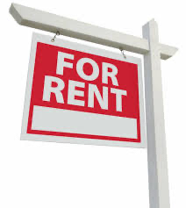
Project Objective, application & Impact
The objective of this project is to find out the regions in the USA that have a higher rental price and what kind of amenities drive the increase in the rental price of the house.
The outcome of this analysis holds profound significance for a diverse array of stakeholders.
Real estate professionals will gain invaluable insights to guide their investment decisions.
Prospective renters will find empowerment in making informed location choices.
Policymakers will access essential information to formulate strategies aimed at addressing the pressing issue of housing affordability.
DATA230 Project Presentation
US Rental Market Analysis

Slide 5
Data Description
The dataset utilized in this project is sourced from Kaggle and was originally compiled by a user named Rekib Ahmed.
This dataset falls under the public domain and was initially collected by Austin Reese on January 7, 2020, with its source being Craiglist.org.
It encompasses a total of 265,190 records related to rental houses, including details about the rental price and various attributes such as the number of bedrooms, bathrooms, parking availability, and laundry facilities. These attributes are crucial in assessing the overall cost of a rental property.
In its entirety, the dataset is composed of 22 columns.
The analysis of these factors and the identification of pertinent trends are instrumental in formulating strategic decisions that empower stakeholders to make well-informed choices.
https://www.kaggle.com/datasets/rkb0023/houserentpredictiondataset
DATA230 Project Presentation
US Rental Market Analysis

Slide 6
Attribute Description
Id: Listing id
url: Listing URL
region: Craigslist region
region_url: Region URL
price: Rent per month (Target Column)
type: Housing type
sqfeet: Total square footage
beds: Number of bedrooms
baths: Number of bathrooms
cats_allowed: Cats allowed Boolean (1 = yes, 0 = no)
dogs_allowed: Dogs allowed Boolean (1 = yes, 0 = no)
DATA230 Project Presentation
US Rental Market Analysis

Slide 7
Attribute Description
smoking_allowed: Smoking allowed Boolean (1 = yes, 0 = no)
wheelchair_access: Has wheelchair access Boolean (1 = yes, 0 = no)
electric_vehicle_charge: Has electric vehicle charger Boolean (1 = yes, 0 = no)
comes_furnished: Comes with furniture Boolean (1 = yes, 0 = no)
laundry_options: Laundry options available
parking_options: Parking options available
image_url: Image URL
description: Description by the poster
lat: Latitude
long: Longitude
state: State of listing
DATA230 Project Presentation
US Rental Market Analysis

Slide 8
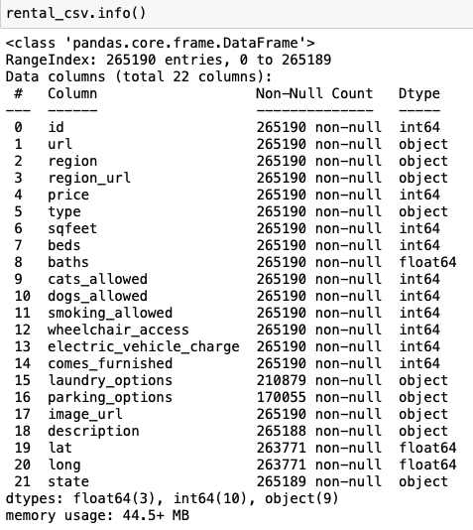
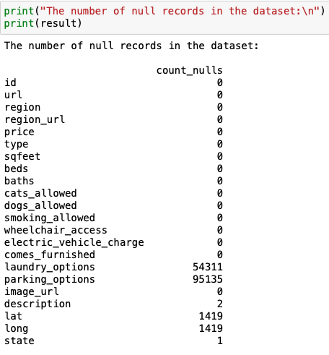
Data Pre-Processing
Dataset Information Null Records in Dataset
DATA230 Project Presentation
US Rental Market Analysis

Slide 9
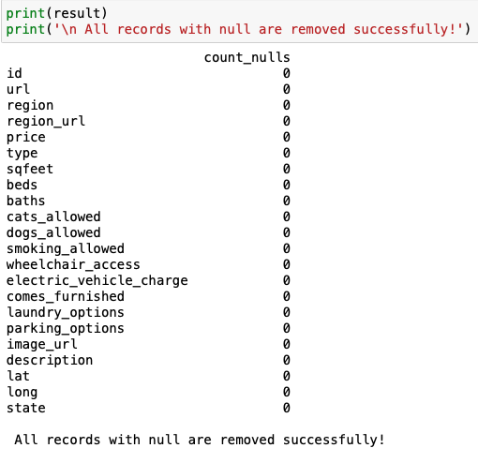

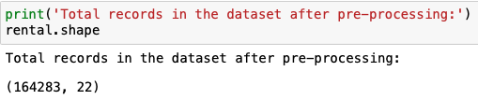
Data Pre-Processing
Handling Null Values Duplicate Records
DATA230 Project Presentation
US Rental Market Analysis

Slide 10
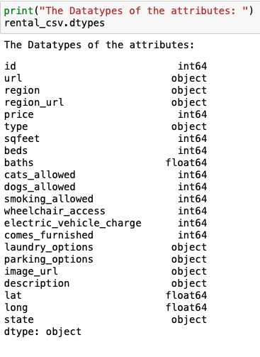
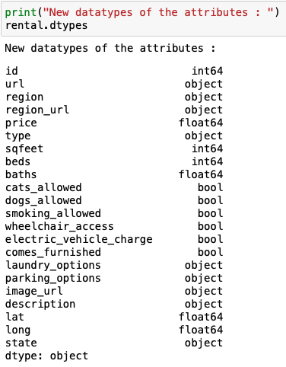
Data Pre-Processing
Attribute Datatypes New Attribute Datatypes
DATA230 Project Presentation
US Rental Market Analysis

Slide 11
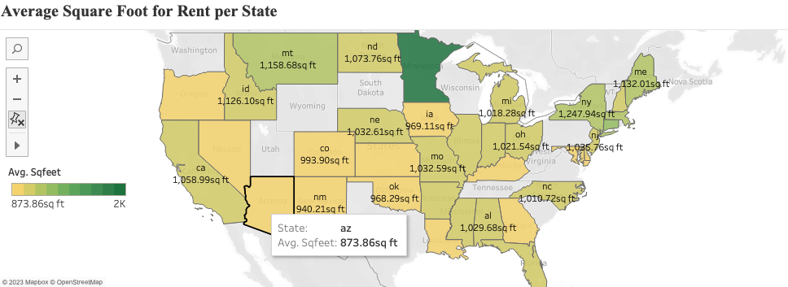
Data Visualizations
Geospatial chat depicting average square foot analysis of all the properties for all states.
DATA230 Project Presentation
US Rental Market Analysis

Slide 12
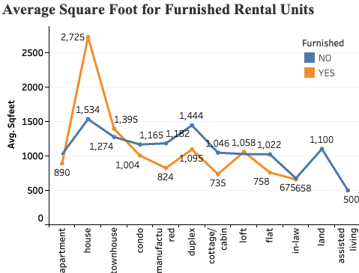
Data Visualizations
The Line chart compares the average square foot of different properties based on whether they come furnished or not.
DATA230 Project Presentation
US Rental Market Analysis

Slide 13
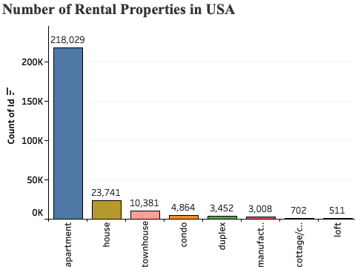
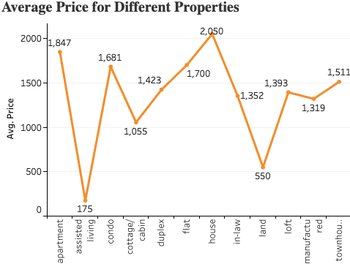
Data Visualizations
The line chart shows the average price of different properties.
Bar chart showing the top 8 rental properties and the number of available accommodations.
DATA230 Project Presentation
US Rental Market Analysis

Slide 14
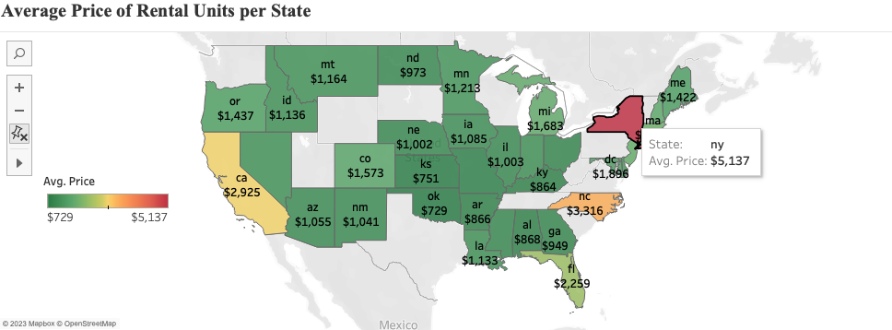
Data Visualizations
The geospatial chart shows the average price of rent all over the USA.
DATA230 Project Presentation
US Rental Market Analysis

Slide 15
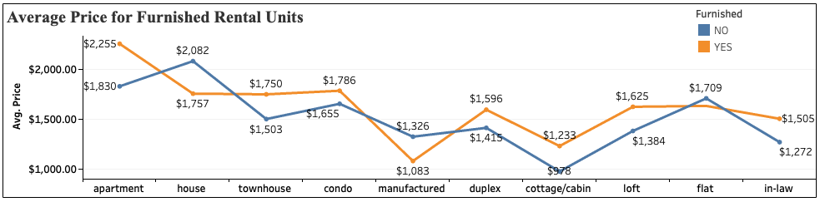
Data Visualizations
The line chart shows the average rental price of different properties based on furnished status.
DATA230 Project Presentation
US Rental Market Analysis

Slide 16
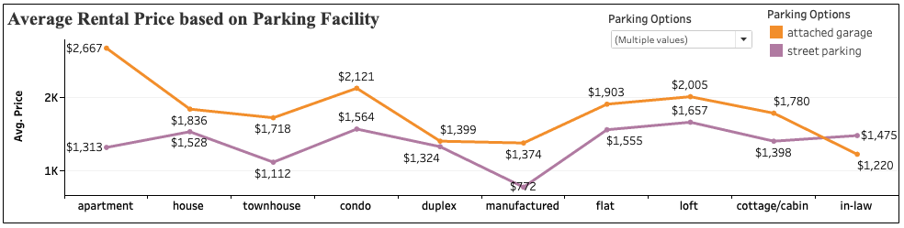
Data Visualizations
The line chart shows the average rental price of different properties based on parking facility.
DATA230 Project Presentation
US Rental Market Analysis

Slide 17
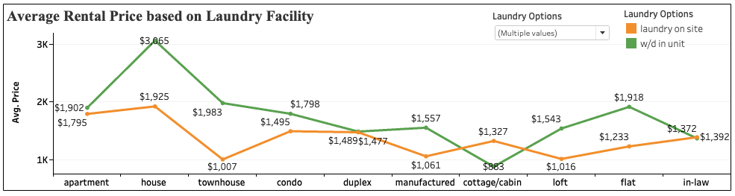
Data Visualizations
The line chart shows the average rental price of different properties based on laundry facility.
DATA230 Project Presentation
US Rental Market Analysis

Slide 18
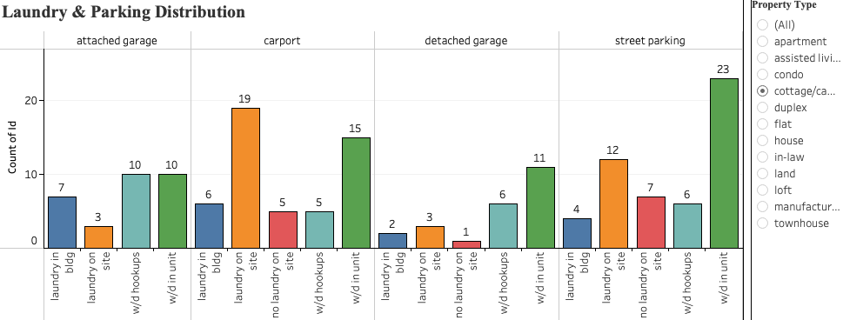
Data Visualizations
Bar chart demonstrating the laundry and parking information for different property types.
DATA230 Project Presentation
US Rental Market Analysis

Slide 19
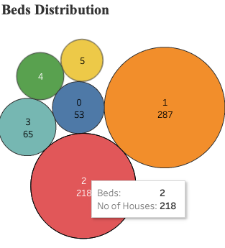
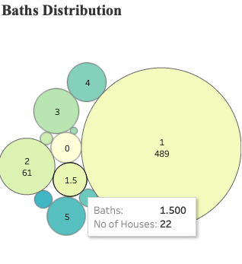
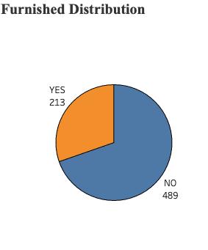
Data Visualizations
Bubble charts showing the distribution of bathrooms and bedrooms for the cottage property type.
Pie chart showing the number of furnished properties for cottage property type.
DATA230 Project Presentation
US Rental Market Analysis

Slide 20
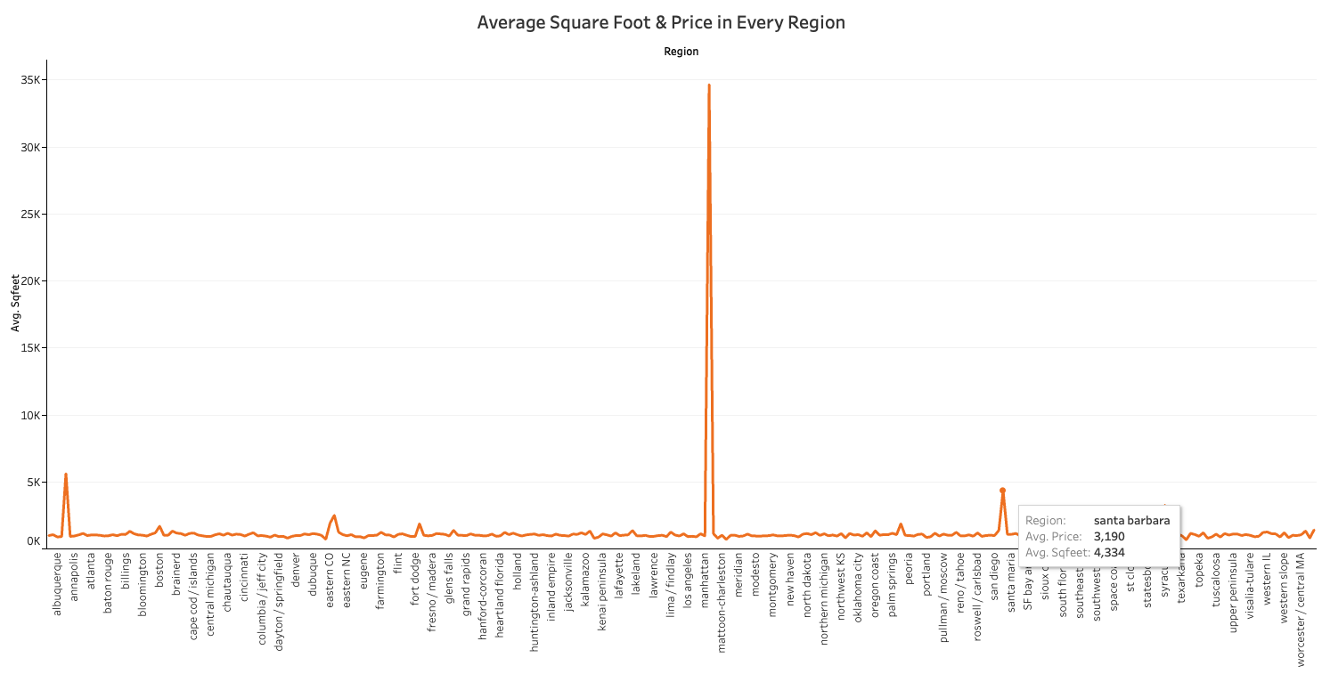
Data Visualizations
DATA230 Project Presentation
US Rental Market Analysis
Notes:
Figure displays the average square footage available and the average price of properties in each region across the USA. This chart offers a dual analysis encompassing both real estate and rental statistics.

Slide 21
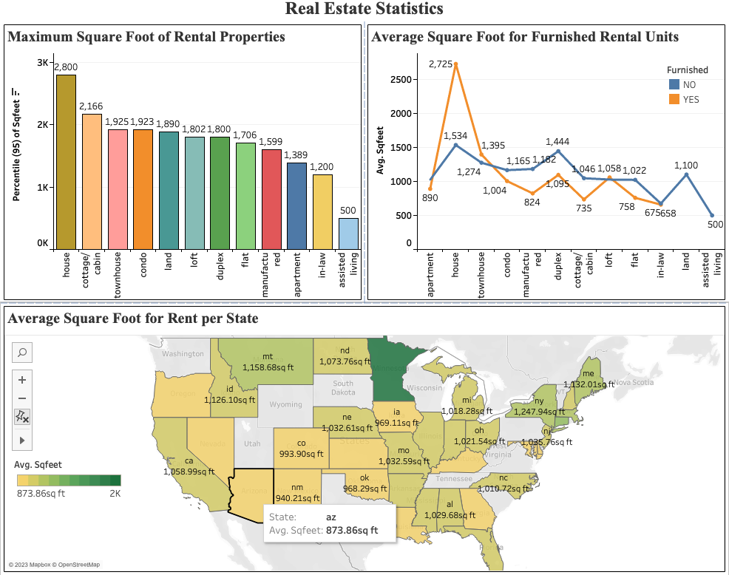
Dashboard Overview
Coverage Area Analysis
DATA230 Project Presentation
US Rental Market Analysis

Slide 22
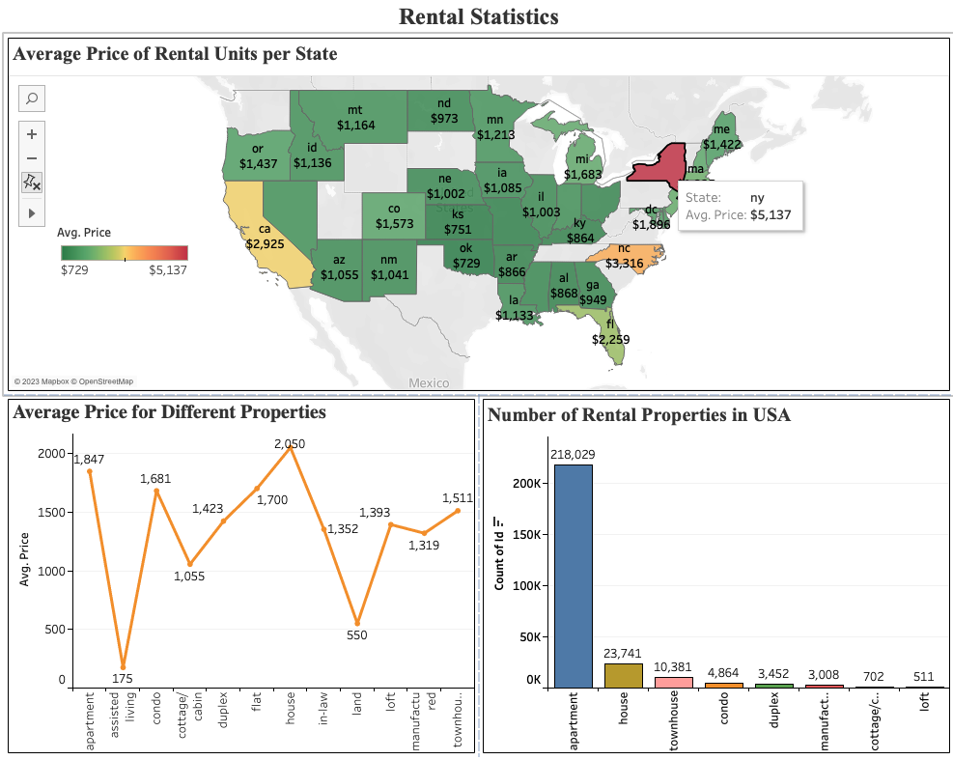
Dashboard Overview
Rental Analysis
DATA230 Project Presentation
US Rental Market Analysis

Slide 23
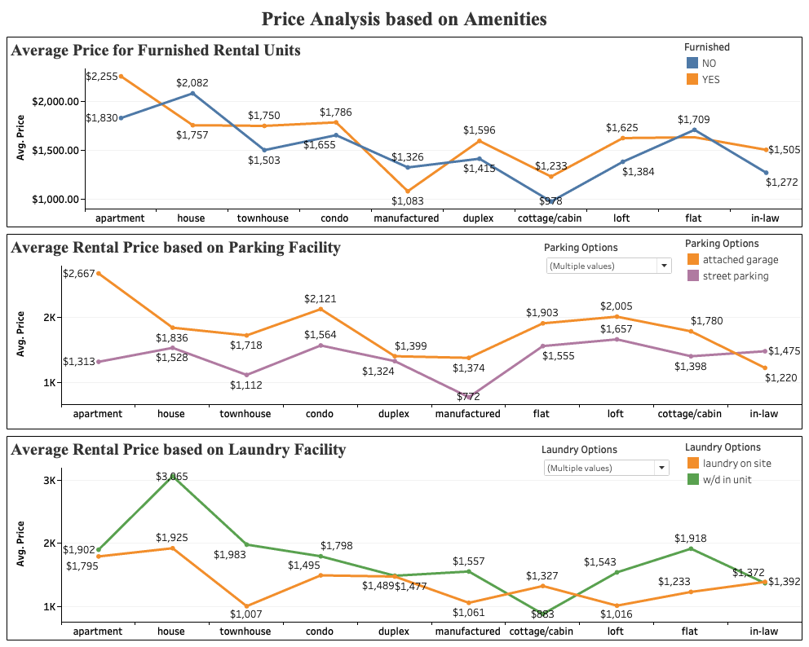
Dashboard Overview
Amenities Vs Rental Price
DATA230 Project Presentation
US Rental Market Analysis

Slide 24
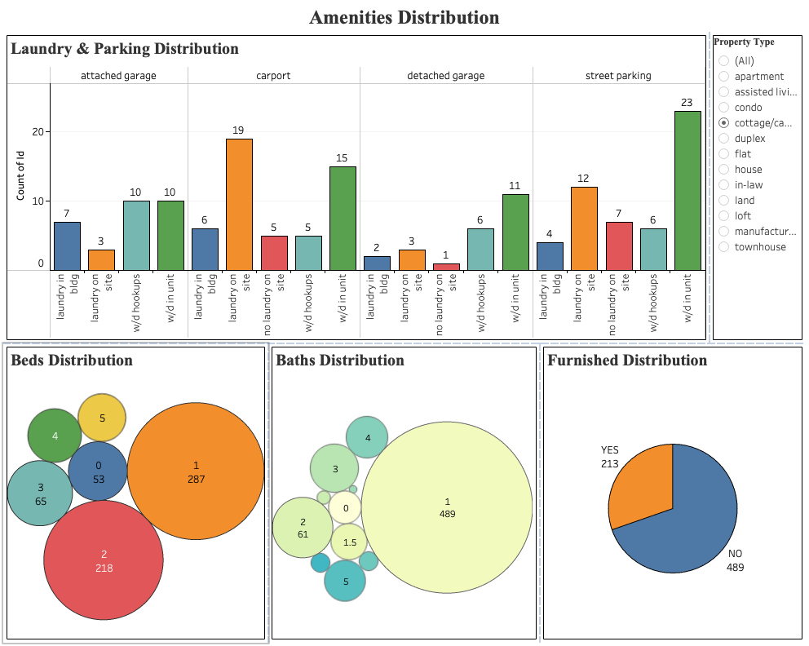
Dashboard Overview
Amenities Analysis
DATA230 Project Presentation
US Rental Market Analysis

Slide 25
Summary
The project aimed to empower users and stakeholders by providing comprehensive visualizations for obtaining detailed information on housing prices and other property characteristics.
Users can leverage these visualizations to acquire insights into the current rental prices for specific amenities they are seeking.
Meanwhile, stakeholders can use this information to identify strategic investment opportunities for optimal returns.
Key insights derived from these visualizations include the prevalence of apartments, which are both numerous and relatively expensive in terms of rent.
Additionally, homes in most states tend to have larger square footage compared to other property types. The presence of amenities varies across regions, indicating regional preferences.
Overall, the bedroom-to-bathroom ratio in all listed properties is generally favorable.
DATA230 Project Presentation
US Rental Market Analysis

Slide 26
References
https://www.istockphoto.com/illustrations/real-estate-market-chart
https://www.threaltyinc.com/state-of-the-central-indiana-rental-market/
https://livingcoloradosprings.com/blog/rentals-in-colorado-springs/
https://www.istockphoto.com/vector/real-estate-market-gm1247802863-363397235
https://matterly.io/integrations/tableau-integration/
DATA230 Project Presentation
US Rental Market Analysis

Slide 27

Thank you
Comparative Performance Analysis - Cassandra Vs MongoDB

